Slide 1

REGULAR EXPRESSION TO FINITE AUTOMATA CONVERSION TOOL
Team Members:
K. Dhanya Sri – 2420030023
M. Vaishnavi – 2420090146
K. Sai Vaishnavi – 2420030660
K. Bhargavi – 2420030661

Slide 2
ABSTRACT
Regular Expressions and Finite Automata are important concepts in Formal Languages and Automata Theory. Regular Expressions describe patterns, while Finite Automata recognize strings belonging to regular languages. Manual conversion can be complex, time-consuming, and prone to errors, especially for expressions with multiple operators.
Our project automates this conversion using Thompson’s Construction algorithm to generate an equivalent ε-NFA. The system accepts a Regular Expression as input and displays the generated states, transitions, transition table, and graphical NFA diagram. It reduces manual effort and helps students understand automata concepts easily.

Slide 3
PROBLEM STATEMENT
Manual conversion of Regular Expressions into Finite Automata requires identifying operators, creating states, and defining transitions. This process becomes difficult and time-consuming for complex expressions containing multiple operators and nested parentheses.
There is also a possibility of errors while connecting states and transitions. Therefore, our project aims to develop an automated tool that converts Regular Expressions into equivalent ε-NFA using Thompson’s Construction, reducing manual effort and providing a clear graphical representation of the automaton.

Slide 4
OBJECTIVES
Convert a given Regular Expression into an equivalent ε-NFA.
Implement Thompson's Construction algorithm.
Display the generated states and transitions.
Provide a graphical representation of the NFA.
Make the conversion process easy to understand and visualize.

Slide 5
EXISTING SYSTEM
In the existing system, the conversion from Regular Expression to Finite Automaton is generally carried out manually. The user analyzes the given expression and identifies operations such as union (|), concatenation, and Kleene star (*).
For each operation, the corresponding automata construction rules are applied. The individual automata are then connected to form the complete automaton. Finally, the user manually identifies the start state and final state and draws the resulting state diagram.

Slide 6
LIMITATIONS OF EXISTING SYSTEM
The conversion process is manual and time-consuming.
Complex Regular Expressions require many conversion steps.
There is a possibility of human errors while creating states and transitions.
Drawing complex automata manually is difficult.
It may be difficult for beginners to understand the complete conversion process.
Converting multiple expressions requires repeating the same manual process.

Slide 7
PROPOSED SYSTEM
The proposed system is a Regular Expression to Finite Automata Conversion Tool that automates the conversion process.
The user enters a valid Regular Expression into the system. The system first validates the input and analyzes its structure, including operators, operands, and parentheses. It then applies a suitable conversion algorithm, such as Thompson's Construction, to generate an equivalent finite automaton.
The generated automaton contains the required states, transitions, start state, and accepting state(s). The result can be displayed graphically so that the user can easily understand and verify the generated automaton.

Slide 8
PROPOSED SYSTEM FLOW
Enter Regular Expression
↓
Input Validation
↓
Parse Regular Expression
↓
Thompson's Construction
↓
Generate ε-NFA
↓
Display Transitions
↓
Display NFA Diagram

Slide 9
ADVANTAGES
Automates the conversion process.
Reduces manual effort and errors.
Saves time.
Provides clear visualization of the automaton.
Makes the concept easier for students to understand.
Can be extended with features such as NFA-to-DFA conversion, DFA minimization, and string testing.

Slide 10
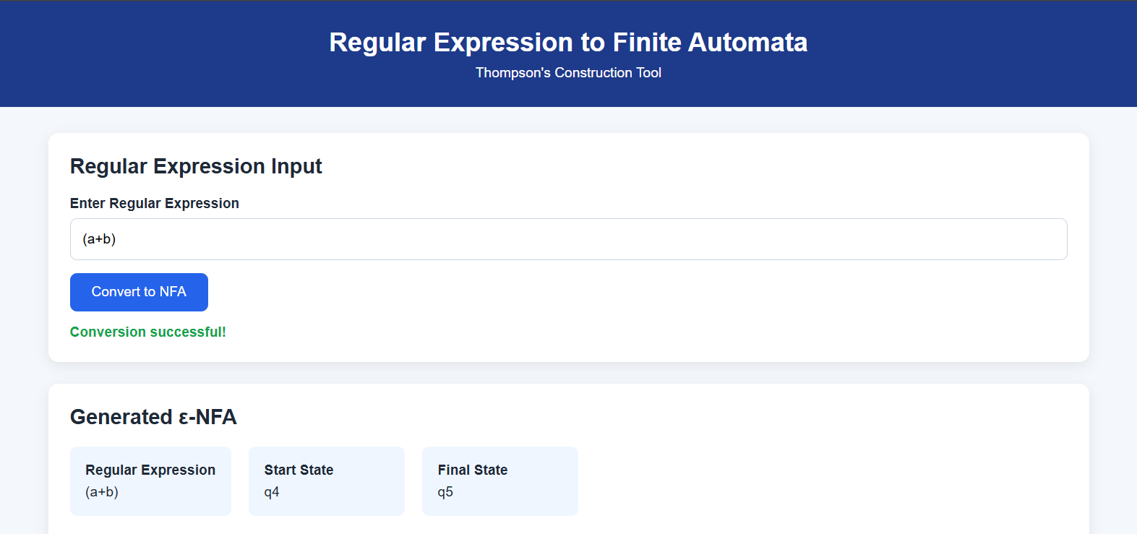
OUTPUTS

Slide 11
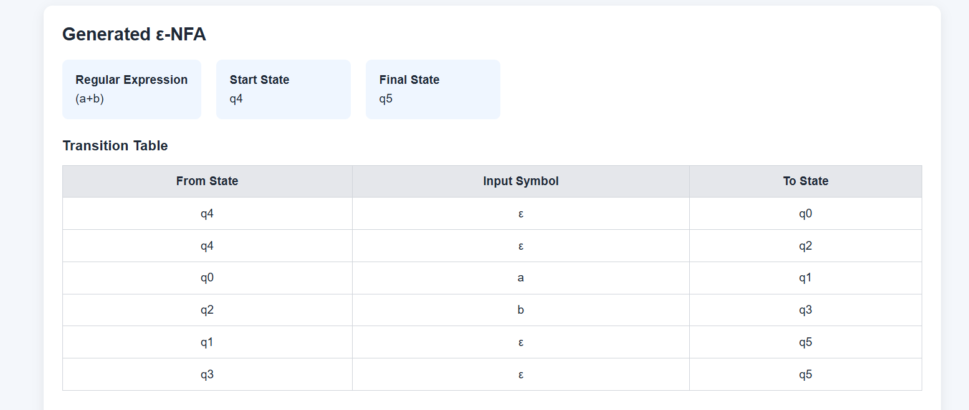

Slide 12
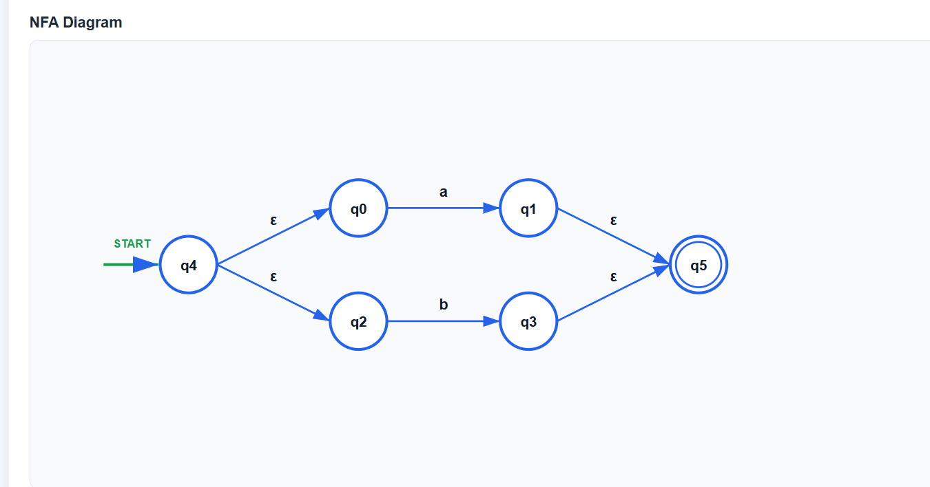

Slide 13
CONCLUSION
The ε-NFA generated from a regular expression using Thompson’s Construction provides an equivalent finite automaton with ε-transitions. It represents the regular expression in the form of states and transitions, making the structure of the expression easier to understand and analyze.
The construction simplifies the conversion process by building the automaton systematically from smaller components.
Thus, ε-NFA provides a clear and effective representation of regular expressions for further automata processing.

